Slide 1

HEALTH RING

Slide 2

INTRODUCTION
A health ring is a sleek, wearable device designed to continuously monitor essential vital signs such as heart rate, heart rate variability, blood oxygen saturation (SpO₂), body temperature, and movement through integrated sensors like optical biosensors and a 9-axis IMU. With a compact form factor ideal for finger wear, it uses low-power controllers (e.g., nRF52840) and communicates wirelessly via Bluetooth Low Energy (BLE) to sync health data with smartphones or cloud platforms. This enables users to track fitness, sleep quality, stress levels, and overall wellness conveniently and in real time.

Slide 3
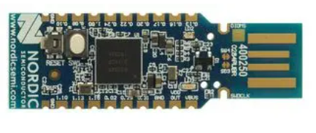
nRF52840 - MCU
Overview:
The nRF52840 is a powerful and energy-efficient System-on-Chip (SoC) designed for wireless applications such as wearables, IoT devices, and smart health products. Its versatile connectivity and low power consumption make it ideal for compact, battery-operated devices like health rings and fitness trackers, where reliable data processing and wireless communication are essential.

Slide 4
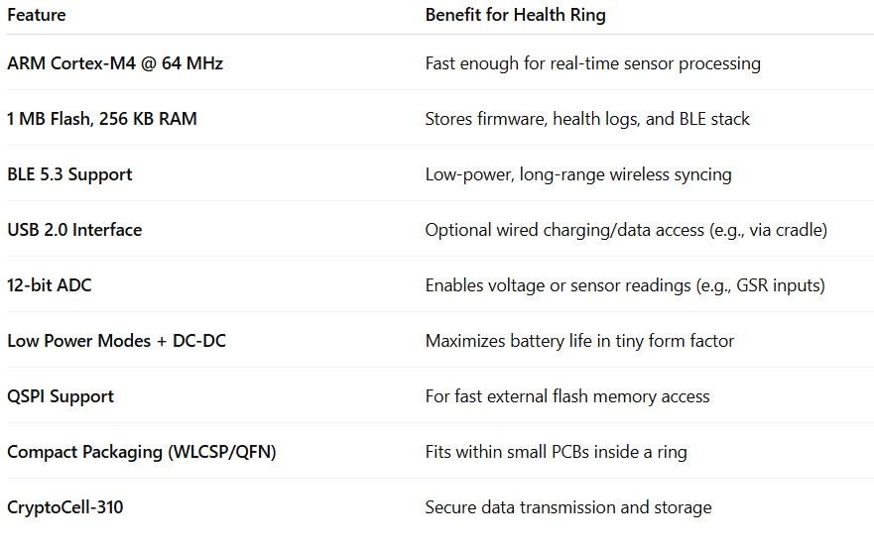
nRF52840 - MCU

Slide 5
nRF52840 - MCU
Applications
Vital Sign Monitoring: Processes data from sensors like MAX86176 (HR, HRV, SpO₂), ICM-20948 (motion), and STTS22H (temperature).
Wireless Communication: Uses Bluetooth Low Energy(BLE) to sync data with a smartphone or cloud service. Enables over-the-air (OTA) firmware updates.
Data Logging: Stores short-term health data in flash memory.
Power Management: Manages power states to extend battery life (essential for small wearables).
Security and Privacy: Uses ARM CryptoCell-310 for encrypting health data before transmission.

Slide 6
SENSORS
MAX86176
Heart Rate (HR)
Heart Rate Variability (HRV)
Blood Oxygen Saturation (SpO₂)
Pulse Transit Time (PTT) – if ECG is enabled
ICM-20948
Motion & Activity Tracking
Respiratory Rate (derived from motion)
Fall Detection (with algorithm)
Sleep Stages & Sleep Quality (with algorithm)
STTS22H
Skin/Peripheral Temperature
Basal Body Temperature (for circadian rhythm, fever tracking)

Slide 7
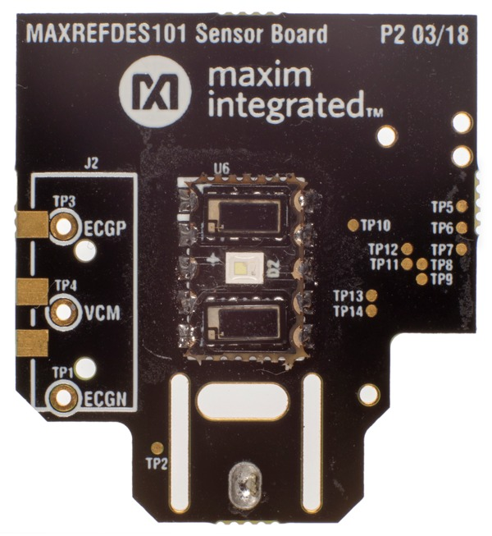
MAX86141
The MAX86141 is an ultra-low-power, compact optical sensor designed for wearable health devices. It specializes in measuring photoplethysmogram (PPG) signals to monitor heart-related vitals such as heart rate (HR), heart rate variability (HRV), and blood oxygen saturation (SpO₂). Its small size and low power consumption make it ideal for compact wearables like health rings and fitness trackers.
.

Slide 8
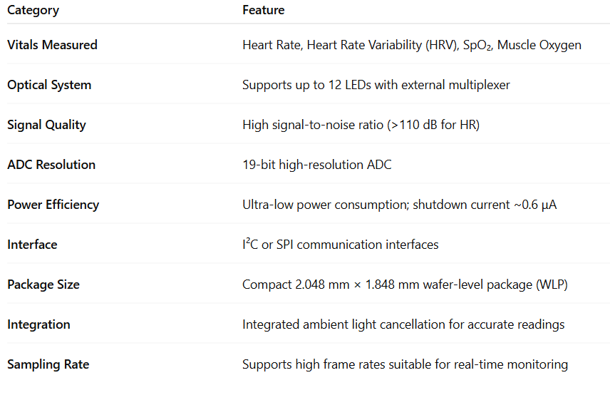
MAX86141

Slide 9
MAX86141
MAX86141 – Vitals Measured :
Heart Rate (HR): Tracks the number of heartbeats per minute using optical PPG signals.
Heart Rate Variability (HRV): Measures variations in time between consecutive heartbeats, important for stress and fitness monitoring.
Blood Oxygen Saturation (SpO₂): Estimates the percentage of oxygen in the blood using red and infrared LEDs.
Muscle Oxygenation: Optional measurement for advanced fitness insights.

Slide 10
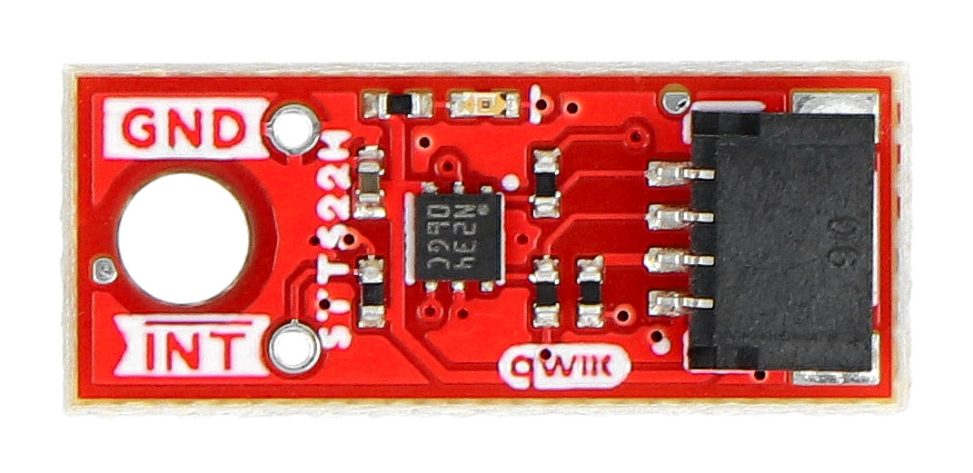
STTS22H
The STTS22H is an ultra-low-power, high-accuracy digital temperature sensor from STMicroelectronics designed for wearable and battery-powered applications. It provides precise skin or peripheral temperature measurement with a small footprint and minimal power consumption, making it ideal for continuous health monitoring in compact devices like rings, watches, and fitness trackers.
The sensor communicates via an I²C interface and operates reliably over a wide temperature range, ensuring accurate basal temperature tracking useful for health insights such as fever detection, and sleep quality monitoring.

Slide 11
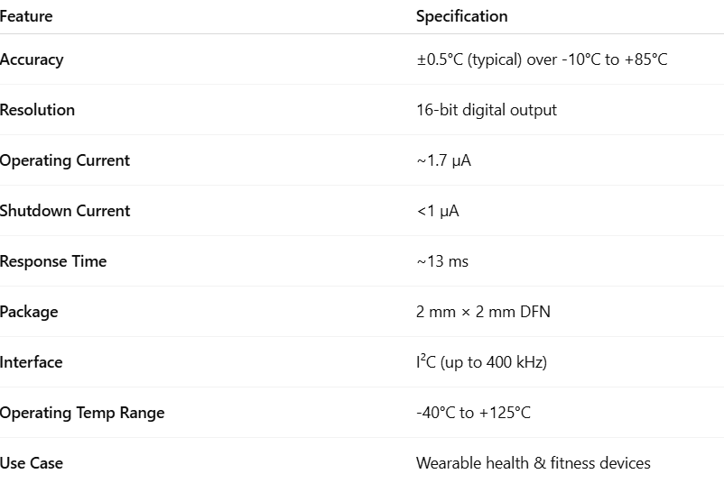
STTS22H

Slide 12
STTS22H – Vitals Measured
Skin Temperature – for monitoring thermal trends on the body surface
Basal Body Temperature – useful for tracking circadian rhythm, menstrual cycles, and fertility
Fever Detection – continuous temperature monitoring for early illness detection
Sleep Monitoring Support – contributes to sleep phase analysis when combined with HR and motion data

Slide 13
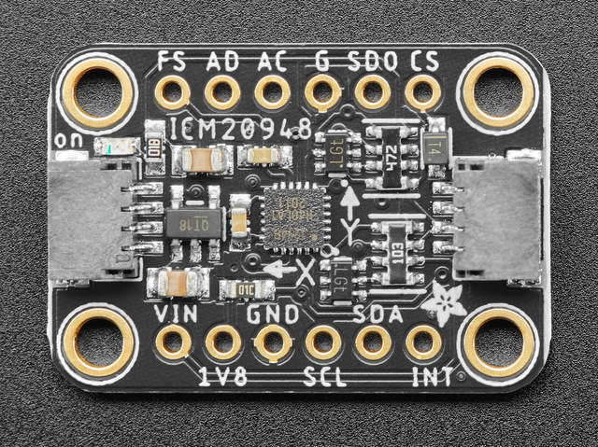
ICM-20948
The ICM-20948 is a compact, low-power, 9-axis motion tracking sensor that integrates a 3-axis gyroscope, 3-axis accelerometer, and 3-axis magnetometer in a single chip. It’s designed for applications like wearables, AR/VR, health monitoring, and motion analysis. Its embedded Digital Motion Processor (DMP) supports sensor fusion and offloads computation from the host MCU, reducing power and latency.

Slide 14
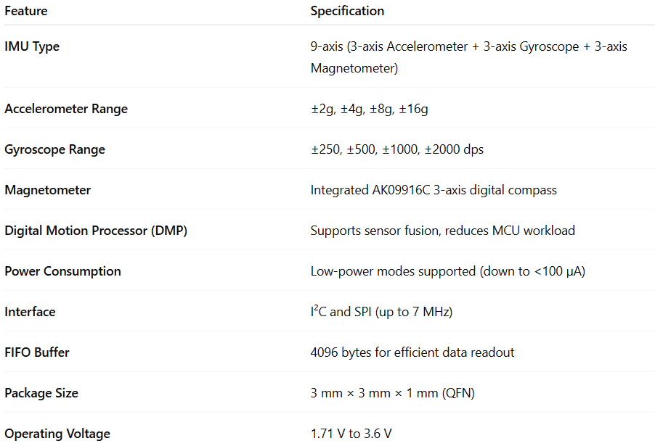
ICM-20948

Slide 15
ICM-20948 – Vitals Measured
Motion & Activity – step counting, posture, general movement
Respiratory Rate (derived) – through chest movement analysis
Sleep Patterns – motion-based sleep stage detection (light/deep sleep)
Fall Detection – sudden movement recognition (with algorithm support)
Balance & Orientation – via sensor fusion (accelerometer + gyro + magnetometer)

Slide 16
Implications in Real life
Heart Rate (HR)
Fitness tracking
Cardiac health monitoring
Heart Rate Variability (HRV)
Stress detection
Recovery and fatigue monitoring
SpO₂ (Blood Oxygen)
Sleep apnea screening
Respiratory health (e.g., COVID-19, COPD)
ECG
Arrhythmia and AFib detection
Cardiac diagnostics
Pulse Transit Time (PTT)
Blood pressure trend estimation
Vascular health monitoring
Temperature
Fever detection
Menstrual/fertility tracking
Sleep phase analysis
Motion (IMU)
Activity and step tracking
Fall detection
Gait and posture analysis
Respiratory Rate (Derived)
Breathing pattern analysis
Sleep and workout monitoring
Sleep Monitoring (Fusion)
Sleep stages and quality
Sleep disorder detection

Slide 17
INTERFACE
Bluetooth Low Energy (BLE)
Bluetooth Low Energy (BLE) is a wireless communication technology optimized for low power consumption, making it ideal for compact wearable devices like health rings. BLE enables the ring to transmit vital health data — such as heart rate, SpO₂, temperature, and motion — to nearby devices like smartphones or health hubs. Its short-range (typically up to 10 meters) and standardized profiles ensure reliable, secure, and efficient data exchange, while preserving battery life for extended wear without frequent charging.

Slide 18
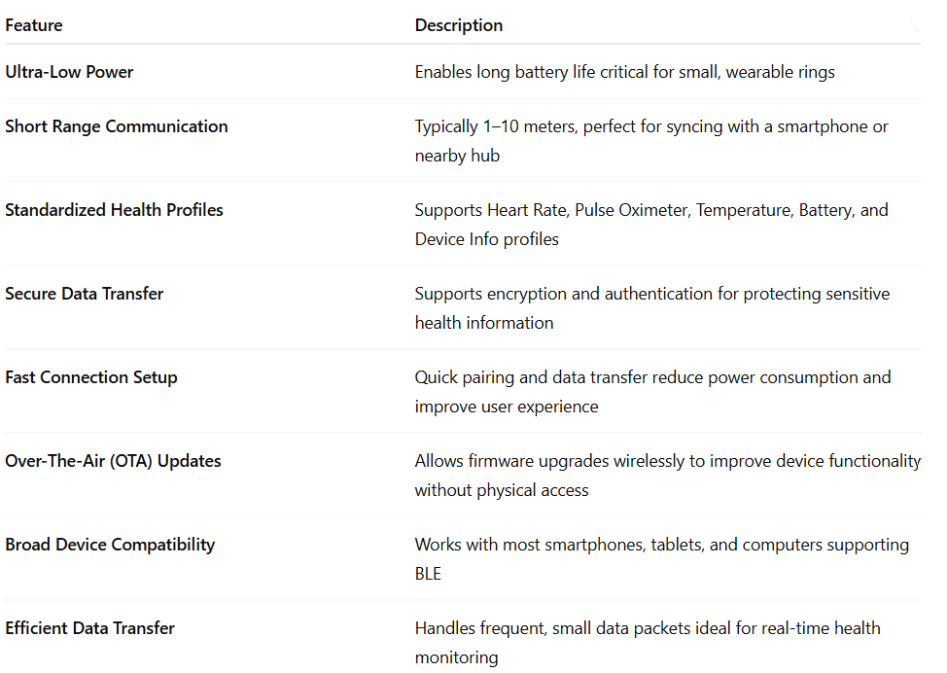
Bluetooth Low Energy (BLE)

Slide 19
RING CHARGER

Slide 20
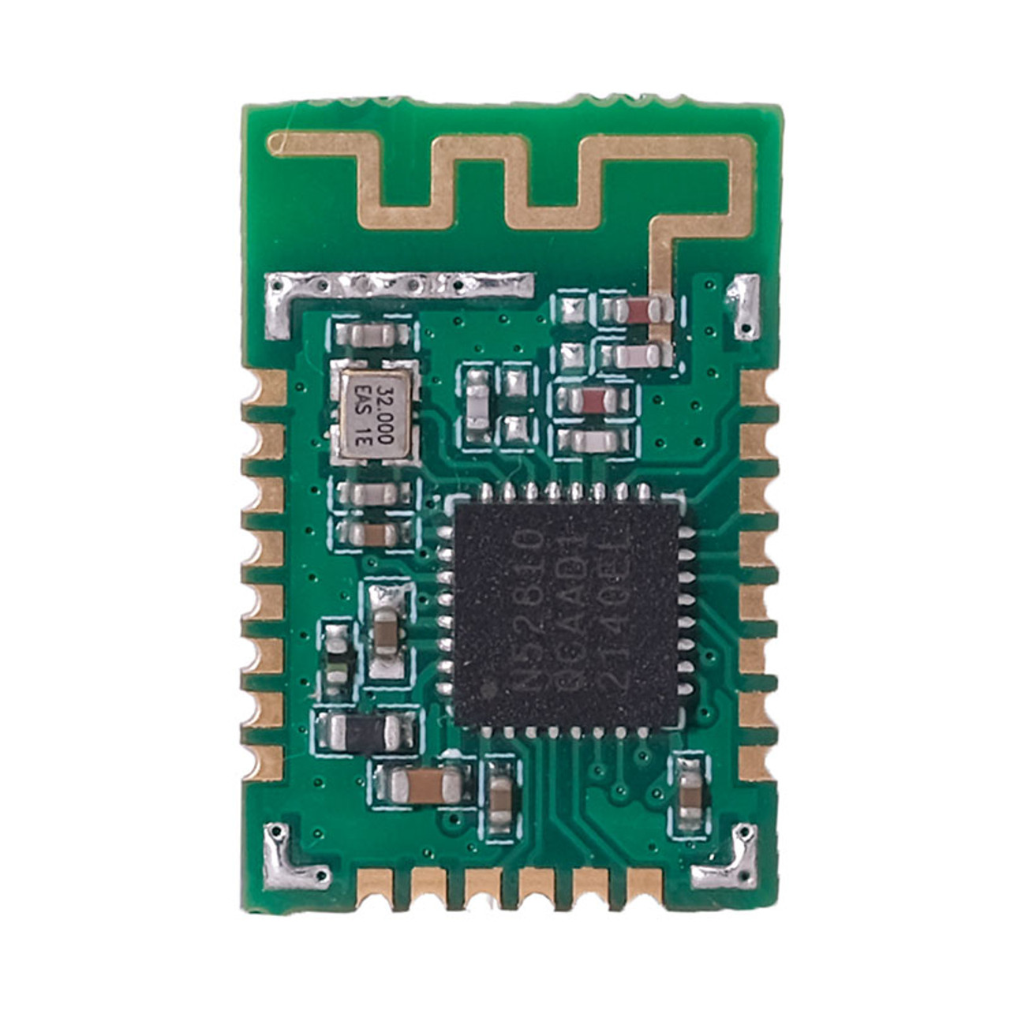
nRF52810 - MCU
The nRF52810 is a low-cost, highly efficient Bluetooth Low Energy (BLE) SoC from Nordic Semiconductor, part of the nRF52 Series. It is designed for applications that need basic BLE functionality, small form factor, and low power consumption, making it a strong fit for wearables and accessories like ring chargers, smart bands, and medical peripherals.

Slide 21
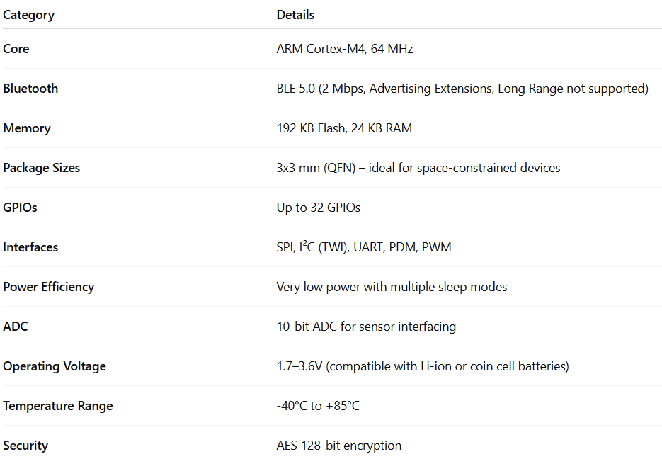
nRF52810

Slide 22
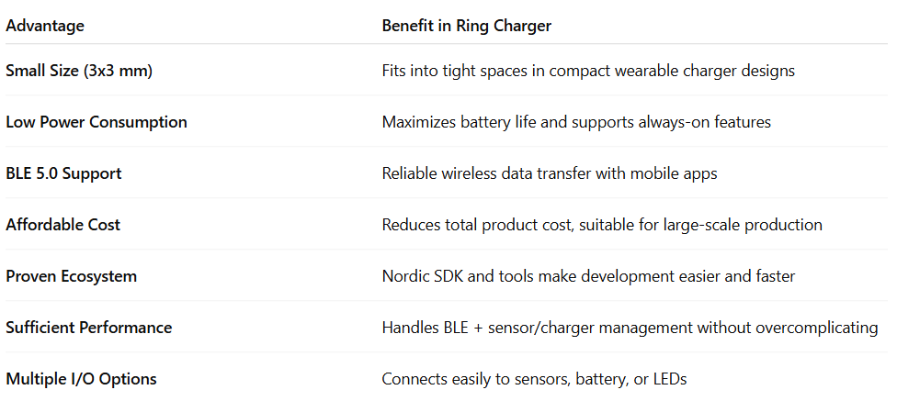

Slide 23
CONCLUSION
The health ring, using MAX86176, ICM-20948, and STTS22H, enables accurate monitoring of heart rate, HRV, SpO₂, temperature, and motion — supporting wellness, sleep, and stress insights.
The ring charger, powered by the compact and energy-efficient nRF52810, ensures reliable BLE communication, charging, and firmware updates.
Together, they form a compact, low-power, and scalable wearable system ideal for real-life health tracking and preventive care.

